Slide 1

6th Grade Math
Unit 3, Lesson 7 Solving Two Step, Real-World Problems with Fractions or Decimals – Part 2 Volume 1, pg. 120

Slide 2


Benchmark
MA.6.NSO.2.3
Solve multi-step, real-world problems involving any of the four operations with positive multi-digit decimals or positive fractions, including mixed numbers.
volume 1, pg. 120

Slide 3
Integrated Mathematical Thinking and Reasoning Standards
MA.K12.MTR.6.1 Assess the reasonableness of solutions.
MA.K12.MTR.7.1 Apply mathematics to real-world contexts.
volume 1, pg. 120

Slide 4

Learning Target
I can solve two-step, real-world problems with decimals or fractions.
volume 1, pg. 120

Slide 5

Warm-Up
volume 1, pg. 120

Slide 6
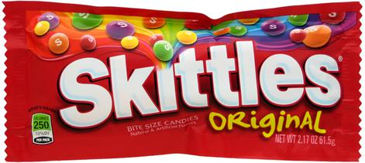
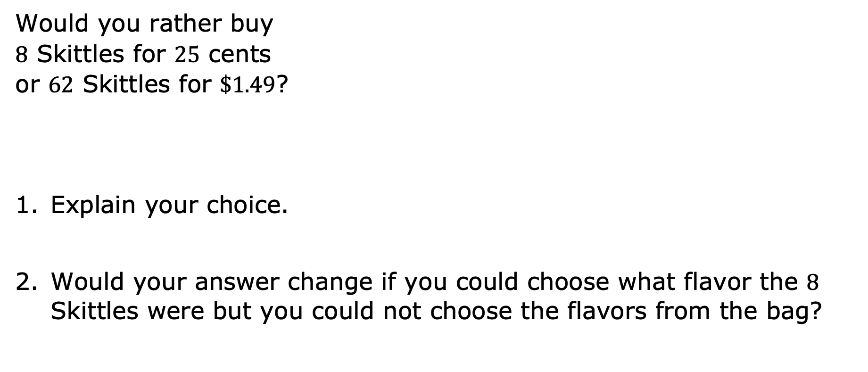
3.7.1 Warm-Up: Would You Rather?
Would you rather buy $8$ Skittles for $25$ cents or $62$ Skittles for $\$1.49$?
Explain your choice.
Would your answer change if you could choose what flavor the $8$ Skittles were but you could not choose the flavors from the bag?
volume 1, pg. 120

Slide 7

Collaboration
volume 1, pg. 121

Slide 8

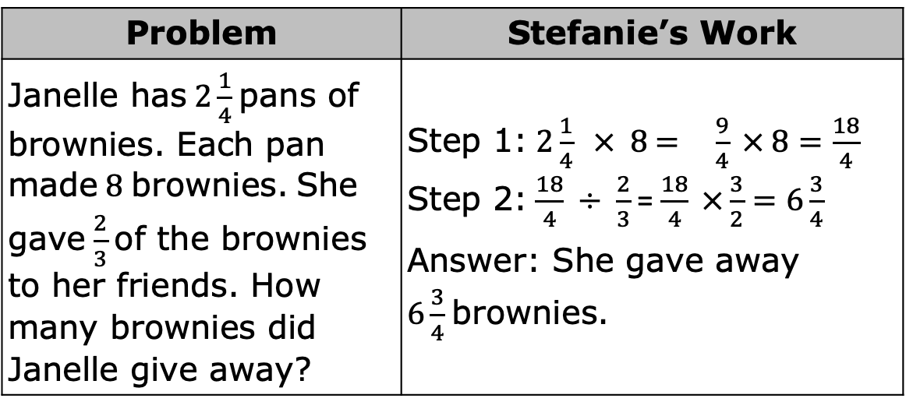
3.7.2 Collaboration: Error Analysis
Stefanie solved the following word problem. Her work is shown.
Evaluate her work and determine where she made mistakes.
Problem | Stefanie’s Work
Janelle has $2\frac{1}{4}$ pans of brownies. Each pan made $8$ brownies. She gave $\frac{2}{3}$ of the brownies to her friends. How many brownies did Janelle give away? | Step 1: $2\frac{1}{4} × 8$ = $\frac{9}{4} × 8=\frac{18}{4}$ Step 2: $\frac{18}{4} ÷ \frac{2}{3}$= $\frac{18}{4} ×\frac{3}{2}=6\frac{3}{4}$ Answer: She gave away $6\frac{3}{4}$ brownies.
volume 1, pg. 121

Slide 9
Help Stefanie understand and learn from her mistakes. Write a brief note to Stefanie explaining what her mistakes were and how she could learn from those mistakes.
Read your partner’s note to Stefanie and offer suggestions for how to improve their note.
Means
I
Start
To
Acquire
Knowledge
Experience
Skills
volume 1, pg. 121

Slide 10

Guided Practice
volume 1, pg. 121

Slide 11

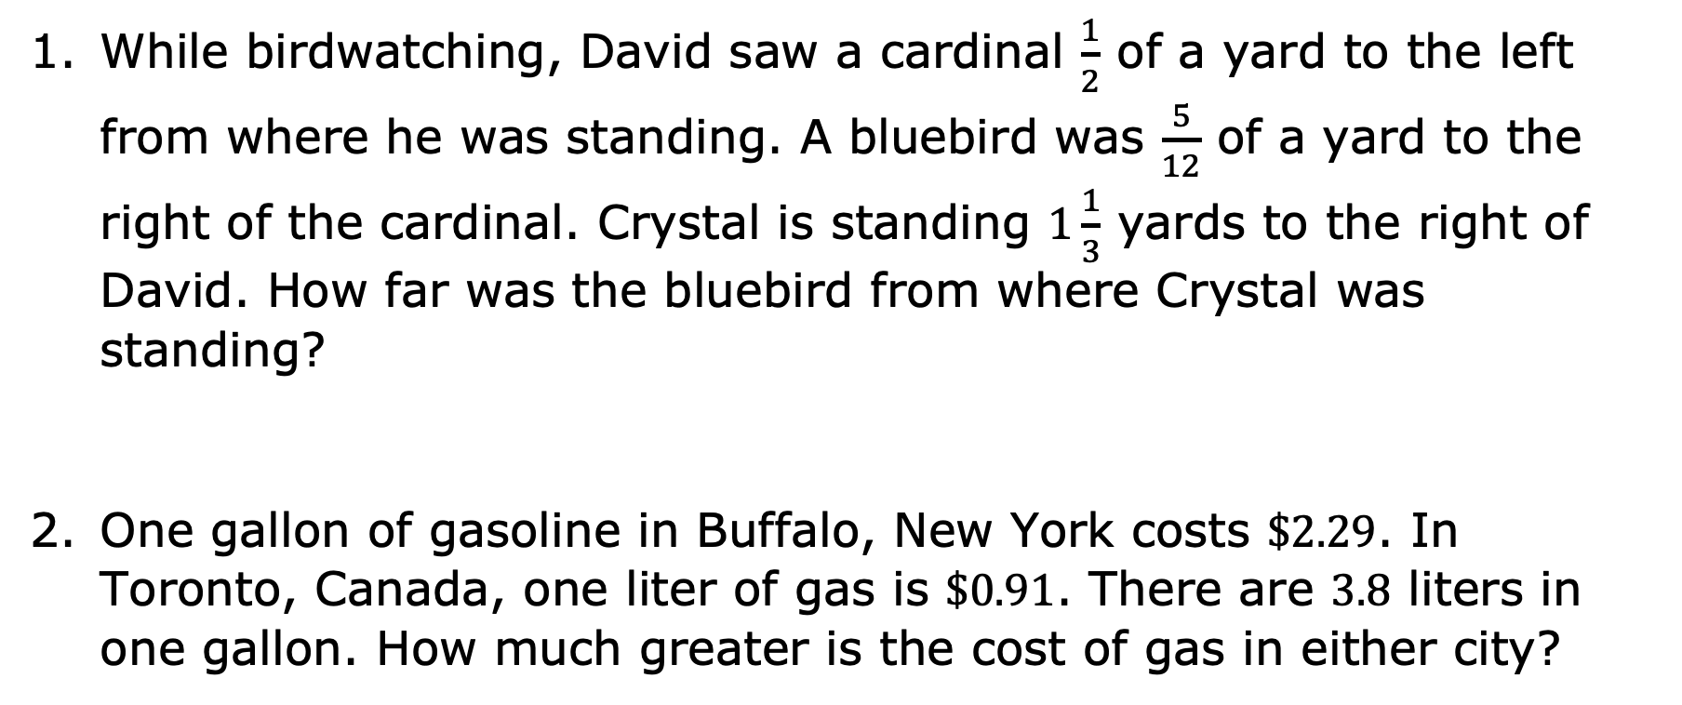
3.7.3 Guided Practice: Two-Step Rational Problems
While birdwatching, David saw a cardinal $\frac{1}{2}$ of a yard to the left from where he was standing. A bluebird was $\frac{5}{12}$ of a yard to the right of the cardinal. Crystal is standing $1\frac{1}{3}$ yards to the right of David. How far was the bluebird from where Crystal was standing?
One gallon of gasoline in Buffalo, New York costs $\$2.29$. In Toronto, Canada, one liter of gas is $\$0.91$. There are $3.8$ liters in one gallon. How much greater is the cost of gas in either city?
volume 1, pg. 121

Slide 12

Your Turn
volume 1, pg. 122

Slide 13
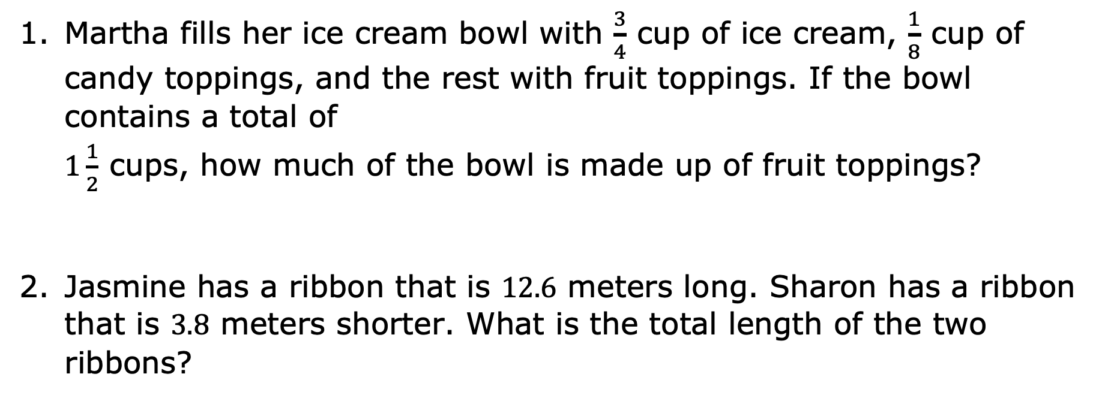
3.7.4 Your Turn!
Martha fills her ice cream bowl with $\frac{3}{4}$ cup of ice cream, $\frac{1}{8}$ cup of candy toppings, and the rest with fruit toppings. If the bowl contains a total of $1\frac{1}{2}$ cups, how much of the bowl is made up of fruit toppings?
Jasmine has a ribbon that is $12.6$ meters long. Sharon has a ribbon that is $3.8$ meters shorter. What is the total length of the two ribbons?
volume 1, pg. 122

Slide 14
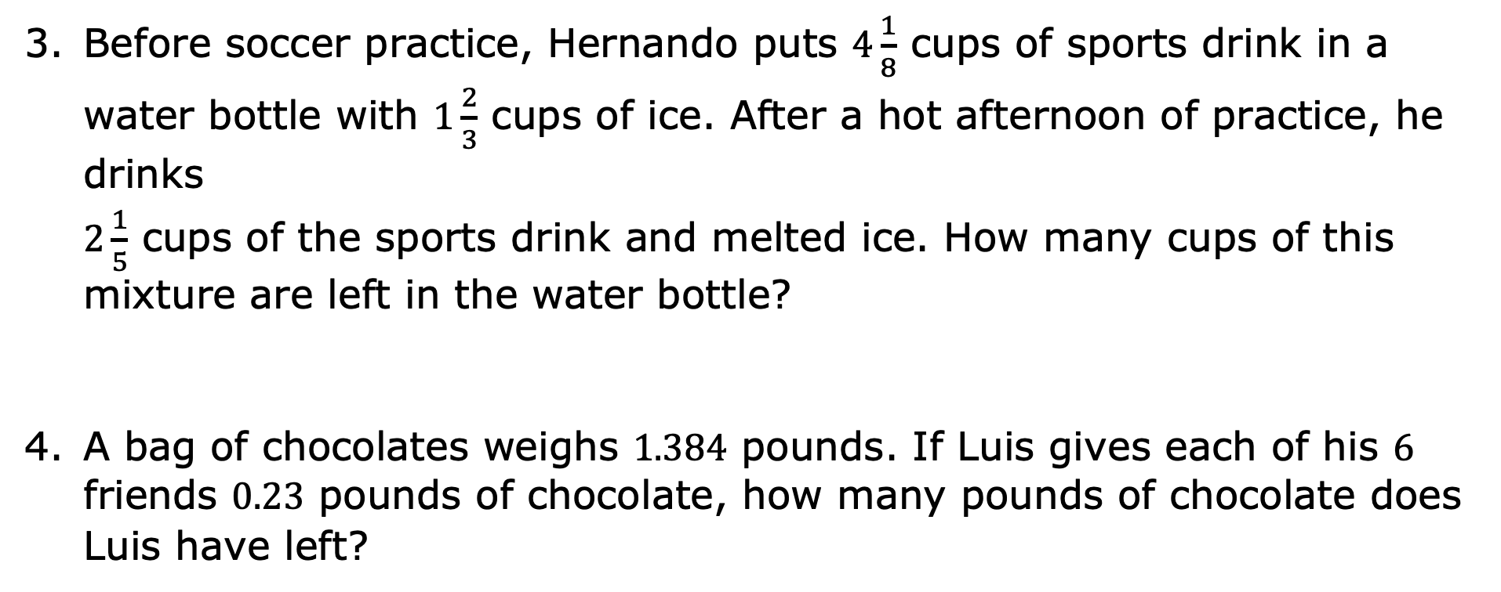
Before soccer practice, Hernando puts $4\frac{1}{8}$ cups of sports drink in a water bottle with $1\frac{2}{3}$ cups of ice. After a hot afternoon of practice, he drinks $2\frac{1}{5}$ cups of the sports drink and melted ice. How many cups of this mixture are left in the water bottle?
A bag of chocolates weighs $1.384$ pounds. If Luis gives each of his $6$ friends $0.23$ pounds of chocolate, how many pounds of chocolate does Luis have left?
volume 1, pg. 122

Slide 15

Wrap-Up
volume 1, pg. 123

Slide 16
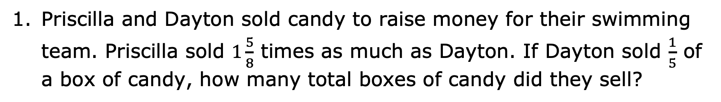
3.7.5 Wrap-Up: Ticket Out the Door
Priscilla and Dayton sold candy to raise money for their swimming team. Priscilla sold $1\frac{5}{8}$ times as much as Dayton. If Dayton sold $\frac{1}{5}$ of a box of candy, how many total boxes of candy did they sell?
volume 1, pg. 123

